Slide 2
Everyone Is A Customer Technical Skills Grounded in Academics: Service Orientation
Essential Questions
How can you communicate with customers and co-workers in a way that will create positive relationships and success at work?
How should you respond when a customer or co-worker is upset or unhappy?

Slide 3
Everyone Is A Customer Technical Skills Grounded in Academics: Service Orientation
Students will understand…
Internal customers are co-workers.
External customers pay for your products or services.
Appropriate communication creates a positive and successful business.

Slide 4
Everyone Is A Customer Technical Skills Grounded in Academics: Service Orientation
Students will know…
Definitions for internal and external customers.
Strategies for successful communication with customers.

Slide 5
Everyone Is A Customer Technical Skills Grounded in Academics: Service Orientation
Students will be able to…
Differentiate between internal and external customers.
Identify strategies to use when working with customers.
Given a scenario, demonstrate how to handle customer service situations.

Slide 6
Technical Skills Grounded in Academics: Service Orientation
Describe the worst experience you ever had as a customer. Write about what the other person said and did that made your experience so unpleasant.

Slide 7
Technical Skills Grounded in Academics: Service Orientation
External customer
Have choice, and if they don't like your product or service can take their business elsewhere. Someone who signs a check, pays an employer, and ultimately makes our paycheck possible. Example: A shopper at a clothing store.

Slide 8
Technical Skills Grounded in Academics: Service Orientation
Internal customer
Can be a co-worker, another department, or a distributor who depends upon us to provide products or services which in turn are utilized to create a deliverable for the external customer. In general, internal customers don't have a choice. For example, if the sales department doesn't like accounting's credit policies, they can't fire that department and hire another.

Slide 9
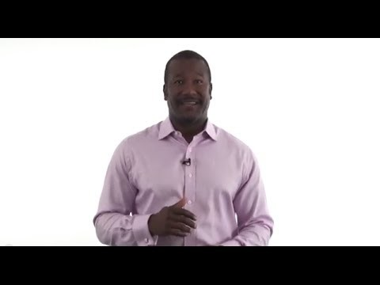
Technical Skills Grounded in Academics: Service Orientation
“What Is Customer Service? The 7 Essentials to Customer Service”
If play prompt does not appear, please click in the center of the slide.

Slide 10
Technical Skills Grounded in Academics: Service Orientation
7 Lessons You Can Learn from Jeff Bezos About Serving the Customer
Don’t Just Listen to Your Customers, Understand Them
“Everyone has to be able to work in a call center.”
Serve the Needs of the Customer
“We’re not competitor obsessed, we’re customer obsessed. We start with what the customer needs and we work backwards.”
The Empty Chair: The Most Important Person in the Room
“Focusing on the customer makes a company more resilient.”
Never Settle for 99%
“We’re not satisfied until it’s 100%.”
Respect Today’s Customer
“If you make customers unhappy in the physical world, they might each tell six friends. If you make customers unhappy on the Internet, they can each tell 6,000.”
Strive to Create a Customer-Centric Company
“If we can arrange things in such a way that our interests are aligned with our customers, then in the long term that will work out really well for customers and it will work out really well for Amazon.”
Don’t Be Afraid to Apologize
“We will use the scar tissue from this painful mistake to help make better decisions going forward, ones that match our mission.”

Slide 11
Technical Skills Grounded in Academics: Service Orientation
Consider what you learned in the video, article, and what you observed when working with your classmates. How can you ensure that all customers receive the best experience working with you?

