Slide 2
Fostering Diversity Workplace Skills: Multi-Cultural Sensitivity and Awareness
Essential Questions
How can I show appreciation for diversity in the workplace?
How can I develop positive relationships with all of my peers and co-workers?

Slide 3
Fostering Diversity Workplace Skills: Multi-Cultural Sensitivity and Awareness
Students will understand…
Strategies exist to help develop and maintain positive relationships in the workplace.
It is important to honor the opinions of others.

Slide 4
Fostering Diversity Workplace Skills: Multi-Cultural Sensitivity and Awareness
Students will know…
How to define key terms related to culture and diversity.
Multi-cultural sensitivity in the workplace is a key to success.

Slide 5
Fostering Diversity Workplace Skills: Multi-Cultural Sensitivity and Awareness
Students will be able to…
Discuss the importance of diversity in the workplace.
Build positive relationships in the workplace.
Demonstrate appreciation for others opinions and culture.

Slide 6
Workplace Skills: Multi-Cultural Sensitivity and Awareness
Describe everything you see in this image.

Slide 7
Workplace Skills: Multi-Cultural Sensitivity and Awareness
Objectives:
Discuss the importance of diversity in the workplace.
Build positive relationships in the workplace.
Demonstrate appreciation for others opinions and culture.

Slide 8
Workplace Skills: Multi-Cultural Sensitivity and Awareness
Multicultural Sensitivity/Awareness
There is possibly no bigger issue in the workplace than diversity. Jobseekers must demonstrate a sensitivity and awareness to other people and cultures. Businesses want a personable professional whose strengths include cultural sensitivity, and an ability to build rapport with a diverse workforce in multicultural settings.

Slide 9
Workplace Skills: Multi-Cultural Sensitivity and Awareness
Diversity
The quality or state of having many different forms, types, ideas.
Sensitivity
An awareness and understanding of the feelings of other people.
Multi-Cultural
Relating to, reflecting, or adapting to diverse culture.

Slide 10
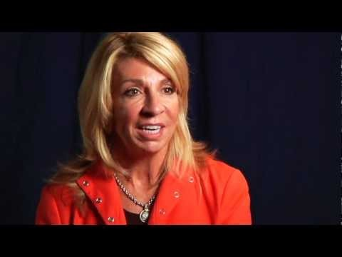
Workplace Skills: Multi-Cultural Sensitivity and Awareness
“What Does Diversity Mean to You?”
If play prompt does not appear, please click in the center of the slide.

Slide 11
Workplace Skills: Multi-Cultural Sensitivity and Awareness
What type of vehicle do you prefer to drive?
What is your favorite season?
What is your favorite sports team?
How do you like to spend your spare time?

Slide 12
Workplace Skills: Multi-Cultural Sensitivity and Awareness
Write a mission statement for a business of your choice that focuses on fostering diversity in the workplace.

