Slide 2
Planning To Plan Workplace Skills: Planning, Organizing and Management
Essential Questions
How do I go about prioritizing tasks?
What is the difference between tasks being “urgent” versus “important?”
How do I go about planning my week when faced with a long “to-do” list?
What process can I use to help me become more efficient and complete a project in the desired time frame?

Slide 3
Planning To Plan Workplace Skills: Planning, Organizing and Management
Students will understand…
Prioritizing tasks can help one become more efficient.
A process can be used to tackle tasks at work.
Before beginning a project, it is helpful to create a game plan that includes tasks, the timeframe, and the person responsible.

Slide 4
Planning To Plan Workplace Skills: Planning, Organizing and Management
Students will know…
The differences between “urgent tasks” and “important tasks”.
How to organize work.
A process that can be used in order to complete a project within the desire timeframe.

Slide 5
Planning To Plan Workplace Skills: Planning, Organizing and Management
Students will be able to…
Define “urgent tasks” and “important tasks.”
Categorize tasks as urgent and/or important.
Describe how categorizing tasks as urgent and/or important can assist with work efficiency.
Develop a plan for a project including tasks, the timeframe, and the person responsible.

Slide 6
Workplace Skills: Planning, Organizing and Management
You’re hiring a new employee. One candidate is described as a planner, the other is described as a procrastinator. Which one would you hire? Why?

Slide 7
Workplace Skills: Planning, Organizing and Management
Objectives:
Define “urgent tasks” and “important tasks.”
Categorize tasks as urgent and/or important.
Describe how categorizing tasks as urgent and/or important can assist with work efficiency.
Develop a plan for a project including tasks, the timeframe, and the person responsible.

Slide 8
Workplace Skills: Planning, Organizing and Management
Urgent Tasks
Based on time
Important Tasks
Based on values and goals

Slide 9
Workplace Skills: Planning, Organizing and Management
Notes, Facts, and Quotes | Reflections and Observations | Compare/Contrast

Slide 10
Workplace Skills: Planning, Organizing and Management
#1 Urgent Tasks Important Tasks | #2 Not Urgent Tasks Important Tasks
#3 Urgent Tasks Not Important Tasks | #4 Not Urgent Tasks Not Important Tasks

Slide 11
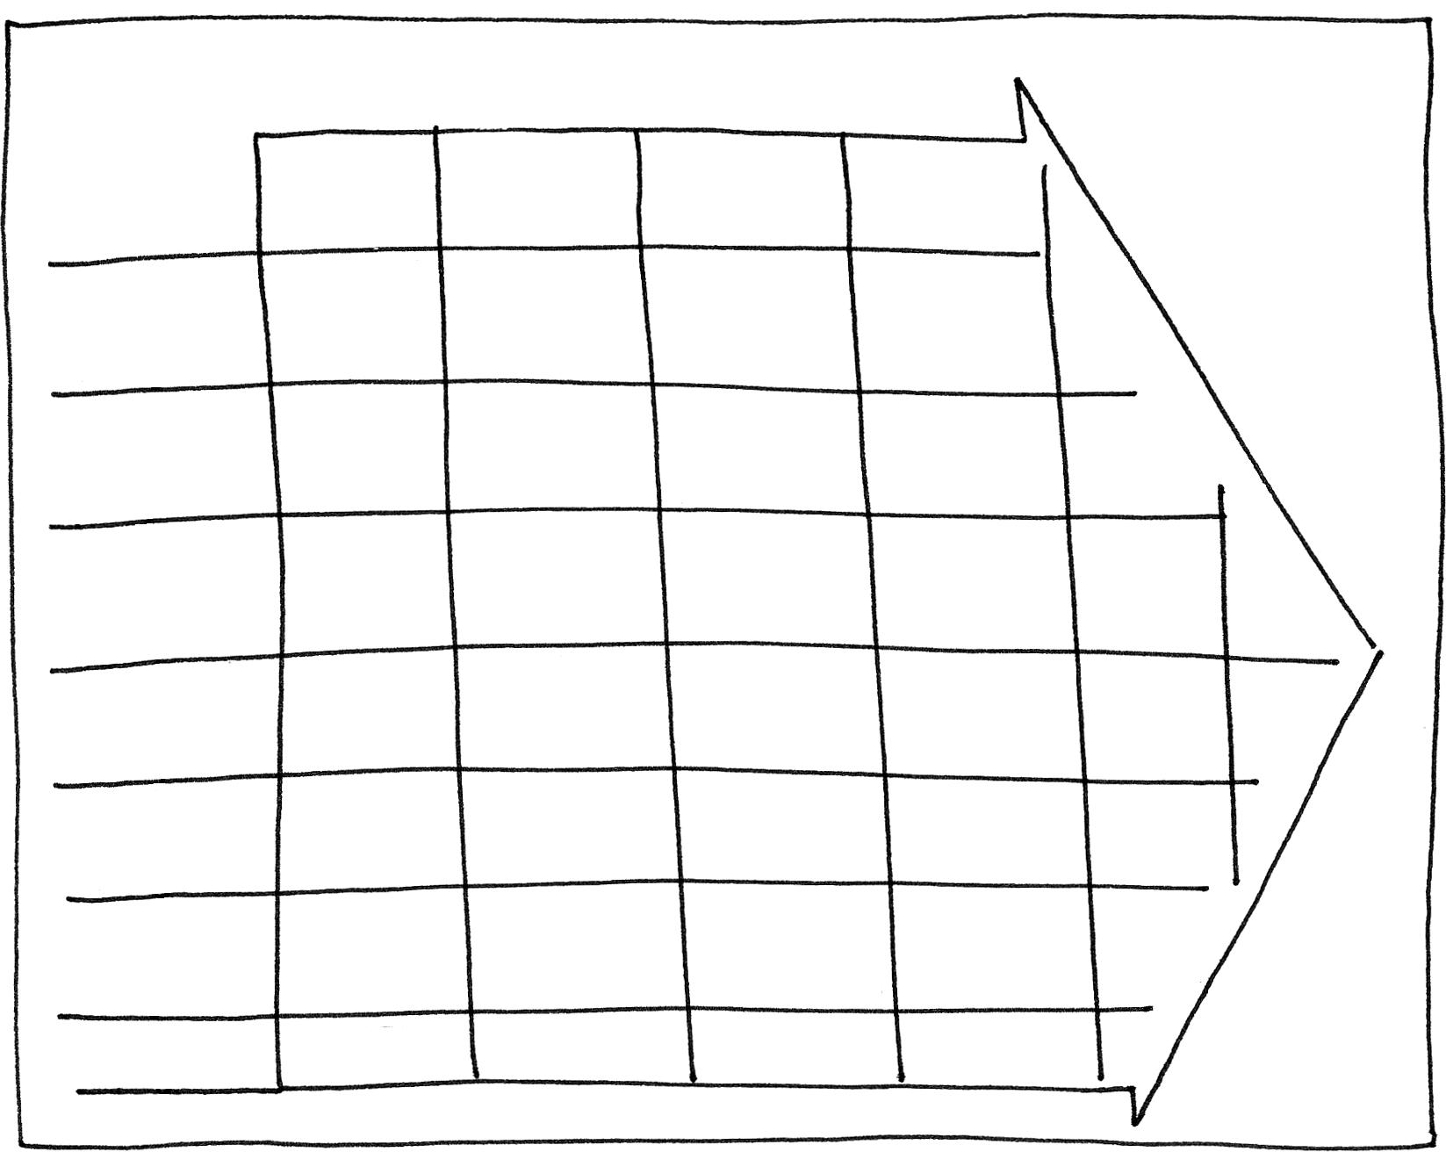
Workplace Skills: Planning, Organizing and Management

