Slide 1


Slide 2
I Believe in Me Personal Skills: Professionalism
Essential Questions
What is self-confidence?
Why is it important to have self-confidence?
What are external characteristics of self-confidence (what does self-confidence look like)?
What is my current level of self-confidence?
How can I develop self-confidence for the workplace?

Slide 3
I Believe in Me Personal Skills: Professionalism
Students will understand…
Self-confident individuals trust their own abilities, have a sense of control of their lives, and believe they will be able to do what they wish, plan and expect.
Self-confident individuals have expectations that are realistic. Even if those are not met, they continue to be positive.
Individuals who lack self-confidence find it difficult to be successful.
Self-confidence gains the attention of others so that an individual’s talents and skills have the chance to shine.

Slide 4
I Believe in Me Personal Skills: Professionalism
Students will know…
Characteristics of self-confidence
How to exhibit self-confidence in the classroom and workplace
How to build and improve self-confidence

Slide 5
I Believe in Me Personal Skills: Professionalism
Students will be able to…
List five characteristics of a self-confident person
Evaluate their own self-confidence level
Describe three ways to improve self-confidence and set a SMART goal for his or herself

Slide 6

Personal Skills: Professionalism
Describe a person who exhibits self-confidence.

Slide 7
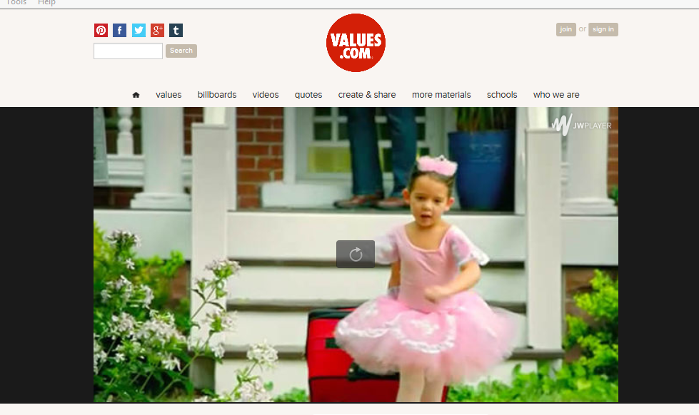
Personal Skills: Professionalism
Clink link to play video
www.values.com/inspirational-stories-tv-spots/125-Ballet

Slide 8
Personal Skills: Professionalism
Objectives:
List five characteristics of a self-confident person.
Evaluate your own self-confidence level.
Describe three ways to improve self-confidence and set a SMART goal for yourself.

Slide 9
Personal Skills: Professionalism
Self-confidence
The quality or state of being certain in oneself and in one’s powers and abilities.

Slide 10
Personal Skills: Professionalism
10 Personality Traits of a Confident Person
Self-Assured
Ambitious
Sociable
Competitive
Risk Taking
Hard Working
Determined
Accepting
Shrewd
Positive

Slide 11
Personal Skills: Professionalism
Quick Write
What characteristics of self-confidence do I exhibit most?
What characteristics should I work to improve for my self-confidence?
Who is someone I could ask for help to improve my self-confidence?

Slide 12
Personal Skills: Professionalism
Self-confidence is part of being professional and it is good to be professional at school and work.
Confidence allows a person to represent their school or business well.
Displaying self-confidence will help others to trust in a person’s knowledge and abilities.
This will make the individual a more effective team player. This also might help a person get a job or position they really want such as a SkillsUSA office.
Displaying self-confidence means a person feels good. When someone feels good, they perform well.

Slide 13
Personal Skills: Professionalism
Building Self-Confidence
Dress sharp
Walk faster
Good posture
Personal commercial
Gratitude
Compliment other people
Sit in the front row
Speak up
Exercise
Contribute

